Slide 1
The Go Programming Language
Alan Dewar
2023-03-28

Slide 2
The Go Programming Language
Who’s Using Go
History and Philosophy
Key Features and Omissions
Language Constructs
Error Handling
Concurrency
Standard Library
Tools
Quirks
Learning Go

Slide 3
My Background
MSc, Computer Science
CUUG Board of Directors since 1998
Synopsys since 2017

Slide 4
Languages I’ve Used
APL
Assembly languages
COMPASS (CDC)
ALM (Multics)
6502
68020
SPARC
BASIC
C, C++
FOCAL
FORTRAN, Fortran
Go
Java
JavaScript
Lisp, Scheme
PL/I
Pascal
PostScript
Prolog
Ruby
Shell: sh, bash, csh
Simula
SNOBOL
Tcl

Slide 5
Who’s Using Go
Google
Core data solutions team: web indexing services
Chrome content optimization service
Firebase hosting team: static web hosting services
Site reliability engineering team
Docker, Kubernetes
Go is the language of containers, cloud

Slide 6
Who’s Using Go
PayPal
Netflix
Meta
Uber
Dropbox
Ethereum
GitLab
Synopsys

Slide 7
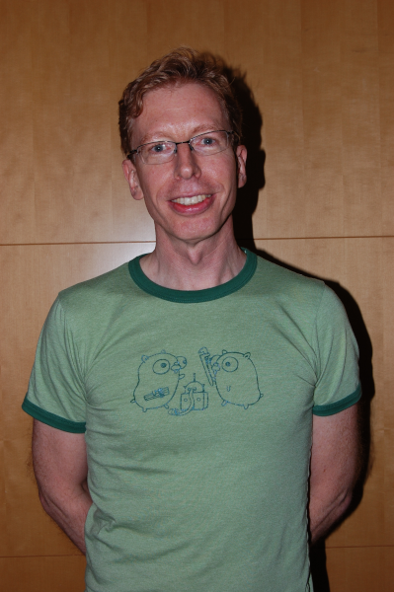
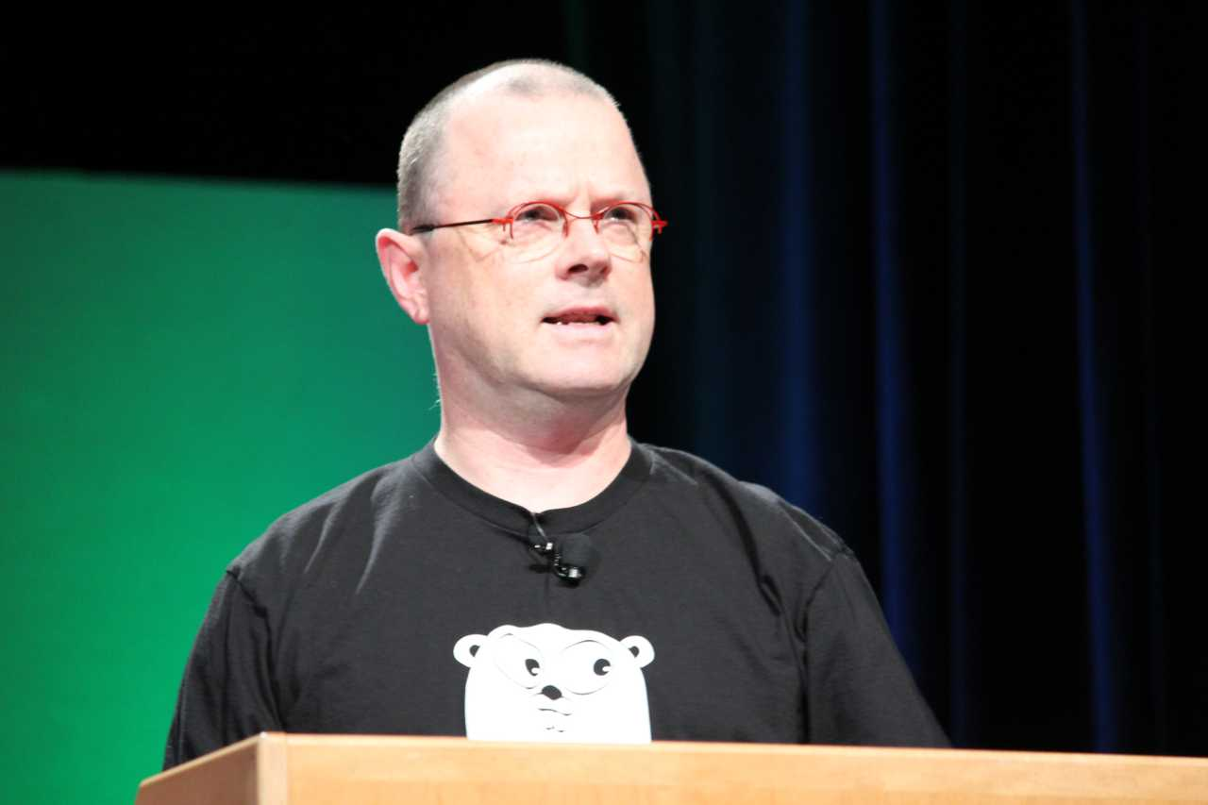
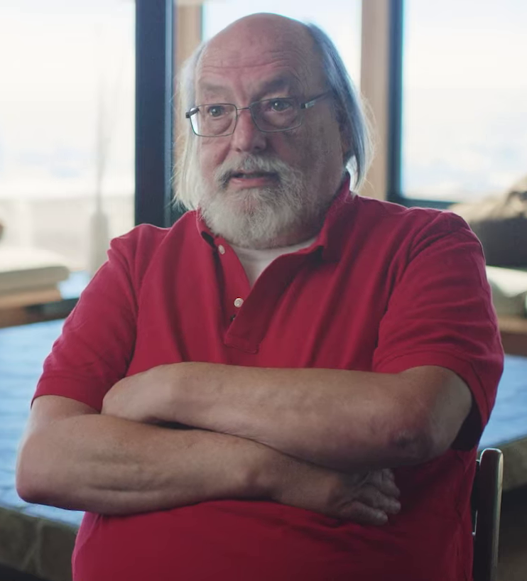
History
Initial Whiteboard Session, 2007-09-21
Robert Griesemer: Google
Rob Pike: Unix, Plan 9, UTF8
Ken Thompson: Unix, Plan 9, UTF8
Rob Pike photo by Kevin Shockey - https://www.flickr.com/photos/shockeyk/4833152910/in/photostream/, CC BY 2.0, https://commons.wikimedia.org/w/index.php?curid=33256884

Slide 8
History
Additional Key Team Members, 2008
Ian Lance Taylor: gcc, Taylor UUCP, gccgo
Russ Cox: Google, interfaces, I/O library

Slide 9
History
Releases
2009-11-10: Public open source project
2012-03-28: go1
2023-02-01: go1.20
Every six months

Slide 10
History
Designed by Google to help solve Google’s problems
Slow builds
Uncontrolled dependencies
C/C++: #include, #ifndef _SYS_STAT_H
Each programmer using a different subset of the language
Code hard to read, poorly documented
Cost of updates
Difficulty of writing automatic tools

Slide 11
Philosophy
Influenced by Plan 9 from Bell Labs
Focus on clarity, simplicity
Clean syntax, few keywords
Simple grammar
All three:
Efficient compilation
Efficient execution
Ease of programming
Familiar
C-like

Slide 12
Philosophy
Compatibility
Go 1 compatibility promise
Programs should continue to work through all 1.x releases
Exceptions
Security
Undefined behavior
Spec errors
Bugs
New fields, methods, and exports
Package “unsafe”

Slide 13
Key Features
Fast compilation to native binary
Static typing
Automatic garbage collection
Static initialization
Error handling
Concurrency
Reflection
Modern standard library
Tools

Slide 14
Key Omissions
Header files (#include)
Forward declarations
Inheritance
Unions
Pointer arithmetic
Implicit type conversion
Including numeric
Default function arguments
Function name overloading
Type aliases
Assignment as expression
++, -- as expression
“implements”
Exceptions
Ternary ?: operator
Assertions

Slide 15
Notable Fatal Errors
Cyclic dependencies
Unused variables
Unused imports

Slide 16
Hello World
package main import "fmt" func main() { fmt.Println("Hello, 世界") }

Slide 17
Language Constructs: Types
bool
int, int8, int16, int32, int64, uint, uint8, uint16, uint32, uint64
float32, float64
complex64, complex128
Array, slice
struct
Pointer
Function
interface
map
channel

Slide 18
Language Constructs: Declarations
Declarations
Go var fn func([]int) int type T struct { a, b int }
C int (*fn)(int[]); struct T { int a, b; }
Scope
Exported (visible to importers): start with capital
Unexported (not visible to importers): start with lower-case

Slide 19
Language Constructs: Statements
foo := bar a, b = b, a
for i := 0; i < 10; i++ { … } for i, thing := range things { … }
if x < 0 { … } else { … }
switch runtime.GOOS { case "darwin": fmt.Println("OS X.") case "linux": fmt.Println("Linux.") default: fmt.Println("Other.") }
func main() { defer fmt.Println("world") fmt.Println("hello") }

Slide 20
Language Constructs: Methods
func with receiver type Vertex struct { X, Y float64 } func (v Vertex) Abs() float64 { return math.Sqrt(v.X*v.X + v.Y*v.Y) }
Not limited to structs type MyFloat float64 func (f MyFloat) Abs() float64 { if f < 0 { return float64(-f) } return float64(f) }

Slide 21
Language Constructs: Interfaces
Set of methods
Duck typing
type Abser interface { Abs() float64 } func (f MyFloat) Abs() float64 { if f < 0 { return float64(-f) } return float64(f) } func main() { var a Abser = MyFloat64(-math.Sqrt2) fmt.Println(a.Abs()) }

Slide 22
Error Handling
error type type error interface { func Error() string }
Function return convention func foo() (string, error) { if happy() { return "Good!", nil } else { return "", fmt.Errorf("I am not happy.") } }

Slide 23
Concurrency
goroutines
Light-weight threads
Shared memory
go f(x, y, z)
Channels
Sending and receiving values of a given type
Receiver blocks until a value is available
Multiple senders and/or receivers
Don’t communicate by sharing memory; share memory by communicating.

Slide 24
Concurrency: Example
func fibo(c, quit chan int) { x, y := 0, 1 for { select { case c <- x: x, y = y, x+y case <-quit: fmt.Println("quit") return } } }
func main() { c := make(chan int) quit := make(chan int) go func() { for i := 0; i < 10; i++ { fmt.Println(<-c) } quit <- 0 }() fibo(c, quit) }

Slide 25
Standard Library (some examples)
archive: tar, zip
compress: bzip2, gzip, lzw, …
crypto: aes, des, ecdsa, md5, rand, rsa, sha512, tls, x509, …
database: sql
encoding: base64, json, xml, …
fmt
html
image: gif, jpeg, png, …
io
math
net: http, mail, url, …
os
reflect
regexp
sync
testing
time

Slide 26
Tools
go run
go build
go mod
go test
go vet
gofmt
godoc
cgo

Slide 27
Quirks
Function’s open brace must be on same line as “func”
Implicit semicolon
Constants are untyped
Interface holding nil value is not equal to nil
goroutine scope for _, v := range values { v := v // This is essential! go fmt.Println(v) }
Date format fmt.Println(time.Now().Format("2006-01-02 15:04:05 -0700"))

Slide 28
Learning Go
Official web site: https://go.dev/
A Tour of Go: https://go.dev/tour/
The Go Playground: https://go.dev/play/
Language specification: https://go.dev/ref/spec
Standard packages: https://pkg.go.dev/std
Effective Go: https://go.dev/doc/effective_go

Slide 29
A Tour of Go

Slide 30
Questions?

Slide 31
Thank You

