Slide 1
Application Security Testing
Alan Dewar
2022-11-22

Slide 2
Application Security Testing
Introduction
Motivating Examples
Government Response
Vulnerability Classification
Vulnerability Enumeration
Attacking the Problem
Demo

Slide 3
Introduction
My Background
MSc, Computer Science
CUUG Board of Directors since 1998
Synopsys since 2017

Slide 4
Introduction
Synopsys Background
Founded in 1986
  Initially silicon only
  Electronic Design Automation (EDA)
Acquired Coverity in 2014
  Static Analysis
  Software Integrity Group (SIG)

Slide 5










Synopsys Today: From Silicon to Software
FY21 Revenue:
~$4.2B
Employees:
16,361
Patents:
3,449
$
Offices:
125
#1 electronic design automation
tools & services
Broadest IP portfolio and
#1 interface, foundation & physical IP
‘Leader’ in Gartner’s Magic Quadrant for application
security testing
Canada
Armenia
Russia
Europe
China
S. Korea
USA
Israel
Japan
India
Taiwan
Southeast Asia
Chile
Market / Region

Slide 6













Software Integrity Group (SIG) Acquisitions
Mar/2014 Coverity (San Francisco, Calgary, Seattle)
May/2014 Kalistick (France)
Apr/2015 Codenomicon (Finland)
Jun/2015 Seeker (Israel)
Nov/2015 Protecode (Ottawa)
Dec/2015 Goanna (Australia)
Dec/2016 Cigital/Codiscope (Dulles/Boston)
Dec/2017 Black Duck Software (Boston, Global Offices)
Jan/2020 Tinfoil (Mountain View)
Jun/2021 Code Dx (New York) Jun/2022 WhiteHat (San Jose)

Slide 7
Synopsys
CUUG Sponsor since 2018

Slide 8
Motivating Examples
SolarWinds: 2019-2020 supply chain attacks
  Trojan introduced into Orion network monitoring software
  Multiple government agencies breached
Colonial Pipeline: 2021 ransomware attack
  Pipeline shut down to contain attack
  Ransom paid (but partially recovered)

Slide 9
Government Response
US: Executive Order on Improving the Nation’s Cybersecurity
Remove Barriers to Threat Information Sharing Between Government and the Private Sector
Modernize and Implement Stronger Cybersecurity Standards in the Federal Government
Improve Software Supply Chain Security
Establish a Cybersecurity Safety Review Board
Create a Standard Playbook for Responding to Cyber Incidents
Improve Investigative and Remediation Capabilities

Slide 10
Government Response
EU: Cyber Resilience Act
Currently a proposal
Bolster cybersecurity rules to ensure more secure hardware and software products
Create conditions for the development of secure products
Create conditions allowing users to take cybersecurity into account
Ensure that manufacturers improve security throughout the whole life cycle
Ensure a coherent cybersecurity framework
Enhance the transparency of security properties
Enable businesses and consumers to use products securely

Slide 11
TLA List*
BSIMM: Building Security In Maturity Model
CAPEC: Common Attack Pattern Enumeration and Classification
CVE: Common Vulnerabilities and Exposures
CVSS: Common Vulnerability Scoring System
CWE: Common Weakness Enumeration
DAST: Dynamic Application Security Testing
FIRST: Forum of Incident Response and Security Teams
IAST: Interactive Application Security Testing
MISRA: Motor Industry Software Reliability Association
NVD: National Vulnerability Database
OSVDB: Open Source Vulnerability Database
OWASP: Open Web Application Security Project
SARIF: Static Analysis Results Interchange Format
SAST: Static Application Security Testing
SBOM: Software Bill Of Materials
SCA: Software Composition Analysis
TLA: Three-Letter Acronym
*Technically initialisms, not acronyms

Slide 12
Classification
CVSS: Common Vulnerability Scoring System
Free and open industry standard for assessing the severity of computer system security vulnerabilities
Assigns severity scores (0 - 10) to vulnerabilities
Metrics:
  Base Metrics for qualities intrinsic to a vulnerability
  Temporal Metrics for characteristics that evolve over the lifetime of vulnerability
  Environmental Metrics for vulnerabilities that depend on a particular implementation or environment
Current version: 3.1
Maintained by FIRST (Forum of Incident Response and Security Teams)

Slide 13
Classification
CWE: Common Weakness Enumeration
Community-developed list of software and hardware weakness types that have security ramifications
CWE Top 25
Maintained by The MITRE Corporation
Current version: 4.5

Slide 14
Classification
2022 CWE Top 25
Rank ID Name
1 CWE-787 Out-of-bounds Write
2 CWE-79 Improper Neutralization of Input During Web Page Generation ('Cross-site Scripting')
3 CWE-89 Improper Neutralization of Special Elements used in an SQL Command ('SQL Injection')
4 CWE-20 Improper Input Validation
5 CWE-125 Out-of-bounds Read
6 CWE-78 Improper Neutralization of Special Elements used in an OS Command ('OS Command Injection')
7 CWE-416 Use After Free
8 CWE-22 Improper Limitation of a Pathname to a Restricted Directory ('Path Traversal')
9 CWE-352 Cross-Site Request Forgery (CSRF)
10 CWE-434 Unrestricted Upload of File with Dangerous Type
11 CWE-476 NULL Pointer Dereference
12 CWE-502 Deserialization of Untrusted Data
13 CWE-190 Integer Overflow or Wraparound
14 CWE-287 Improper Authentication
15 CWE-798 Use of Hard-coded Credentials

Slide 15
Classification
2022 CWE Top 25 (continued)
Rank ID Name
16 CWE-862 Missing Authorization
17 CWE-77 Improper Neutralization of Special Elements used in a Command ('Command Injection')
18 CWE-306 Missing Authentication for Critical Function
19 CWE-119 Improper Restriction of Operations within the Bounds of a Memory Buffer
20 CWE-276 Incorrect Default Permissions
21 CWE-918 Server-Side Request Forgery (SSRF)
22 CWE-362 Concurrent Execution using Shared Resource with Improper Synchronization ('Race Condition')
23 CWE-400 Uncontrolled Resource Consumption
24 CWE-611 Improper Restriction of XML External Entity Reference
25 CWE-94 Improper Control of Generation of Code ('Code Injection')

Slide 16
Classification
OWASP: Open Web Application Security Project
Online community that produces freely-available articles, methodologies, documentation, tools, and technologies in the field of web application security
OWASP Top 10
Led by non-profit OWASP Foundation

Slide 17
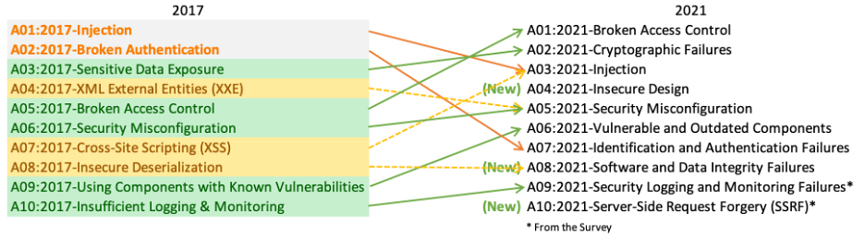
Classification
OWASP Top 10

Slide 18
Classification
MISRA: Motor Industry Software Reliability Association
Guidelines for the software developed for electronic components used in the automotive industry
C/C++ only
Latest revision was in 2019

Slide 19
Enumeration
CVE: Common Vulnerabilities and Exposures
Mission: identify, define, and catalog publicly disclosed cybersecurity vulnerabilities
Recent examples
  December 2021: Apache Log4j
    CVE-2021-44228
  November 2022: OpenSSL
    CVE-2022-3602
    CVE-2022-3786

Slide 20
Enumeration
NVD: National Vulnerability Database
U.S. government repository of standards based vulnerability management data
Links to CVEs

Slide 21
Attacking the Problem
Contexts
Developer
  Command line
  IDE
Build Manager
  CI/CD: Continuous Integration, Continuous Delivery/Deployment
Security Consultant
  One-shot overall assessment

Slide 22
Attacking the Problem
Tradeoffs
Speed vs. thoroughness
  Developers need speed
  Security consultants need thorough results
False positives vs. false negatives
  High aggressiveness: false positives (noise)
  Low aggressiveness: false negatives (missed defects)

Slide 23
Attacking the Problem
Security Practices
Analyze your code
  SAST/DAST/IAST/etc.
Review third-party code
  SCA: Software Composition Analysis
  SBOM: Software Bill of Materials

Slide 24
Attacking the Problem
Types of Testing
SAST: Static Analysis Security Testing
DAST: Dynamic Analysis Security Testing
  Fuzzing
IAST: Interactive Analysis Security Testing
Penetration testing

Slide 25
Attacking the Problem
SAST: Static Analysis Security Testing
Examines source code
White box approach
No execution
Abstract interpretation
  Possible code paths
  Variable value ranges (e.g., positive/negative/zero, null/non-null)

Slide 26
Attacking the Problem
DAST: Dynamic Application Security Testing
Tests executing code
Black box approach
Fuzzing
  Range of potentially-invalid inputs

Slide 27
Attacking the Problem
IAST: Interactive Application Security Testing
Instruments executing code
Manual or automated testing

Slide 28

Attacking the Problem
Penetration Testing
Authorized simulated attack
Same tools as attackers would use

Slide 29
Attacking the Problem
Managing It All
Intelligent Orchestration
  Decide what testing to apply
  Decide aggressiveness levels
Correlation, De-duplication
  Combine results from various tools
  SARIF: Static Analysis Results Interchange Format

Slide 30
Attacking the Problem
Best Practices
BSIMM: Building Security In Maturity Model
CSO/CISO: Chief (Information) Security Officer
DevOps -> DevSecOps
  Introduce security early in the software development life cycle
Security Champions
  Familiar with product under development
  Focus on security concerns
Security testing as release condition

Slide 31
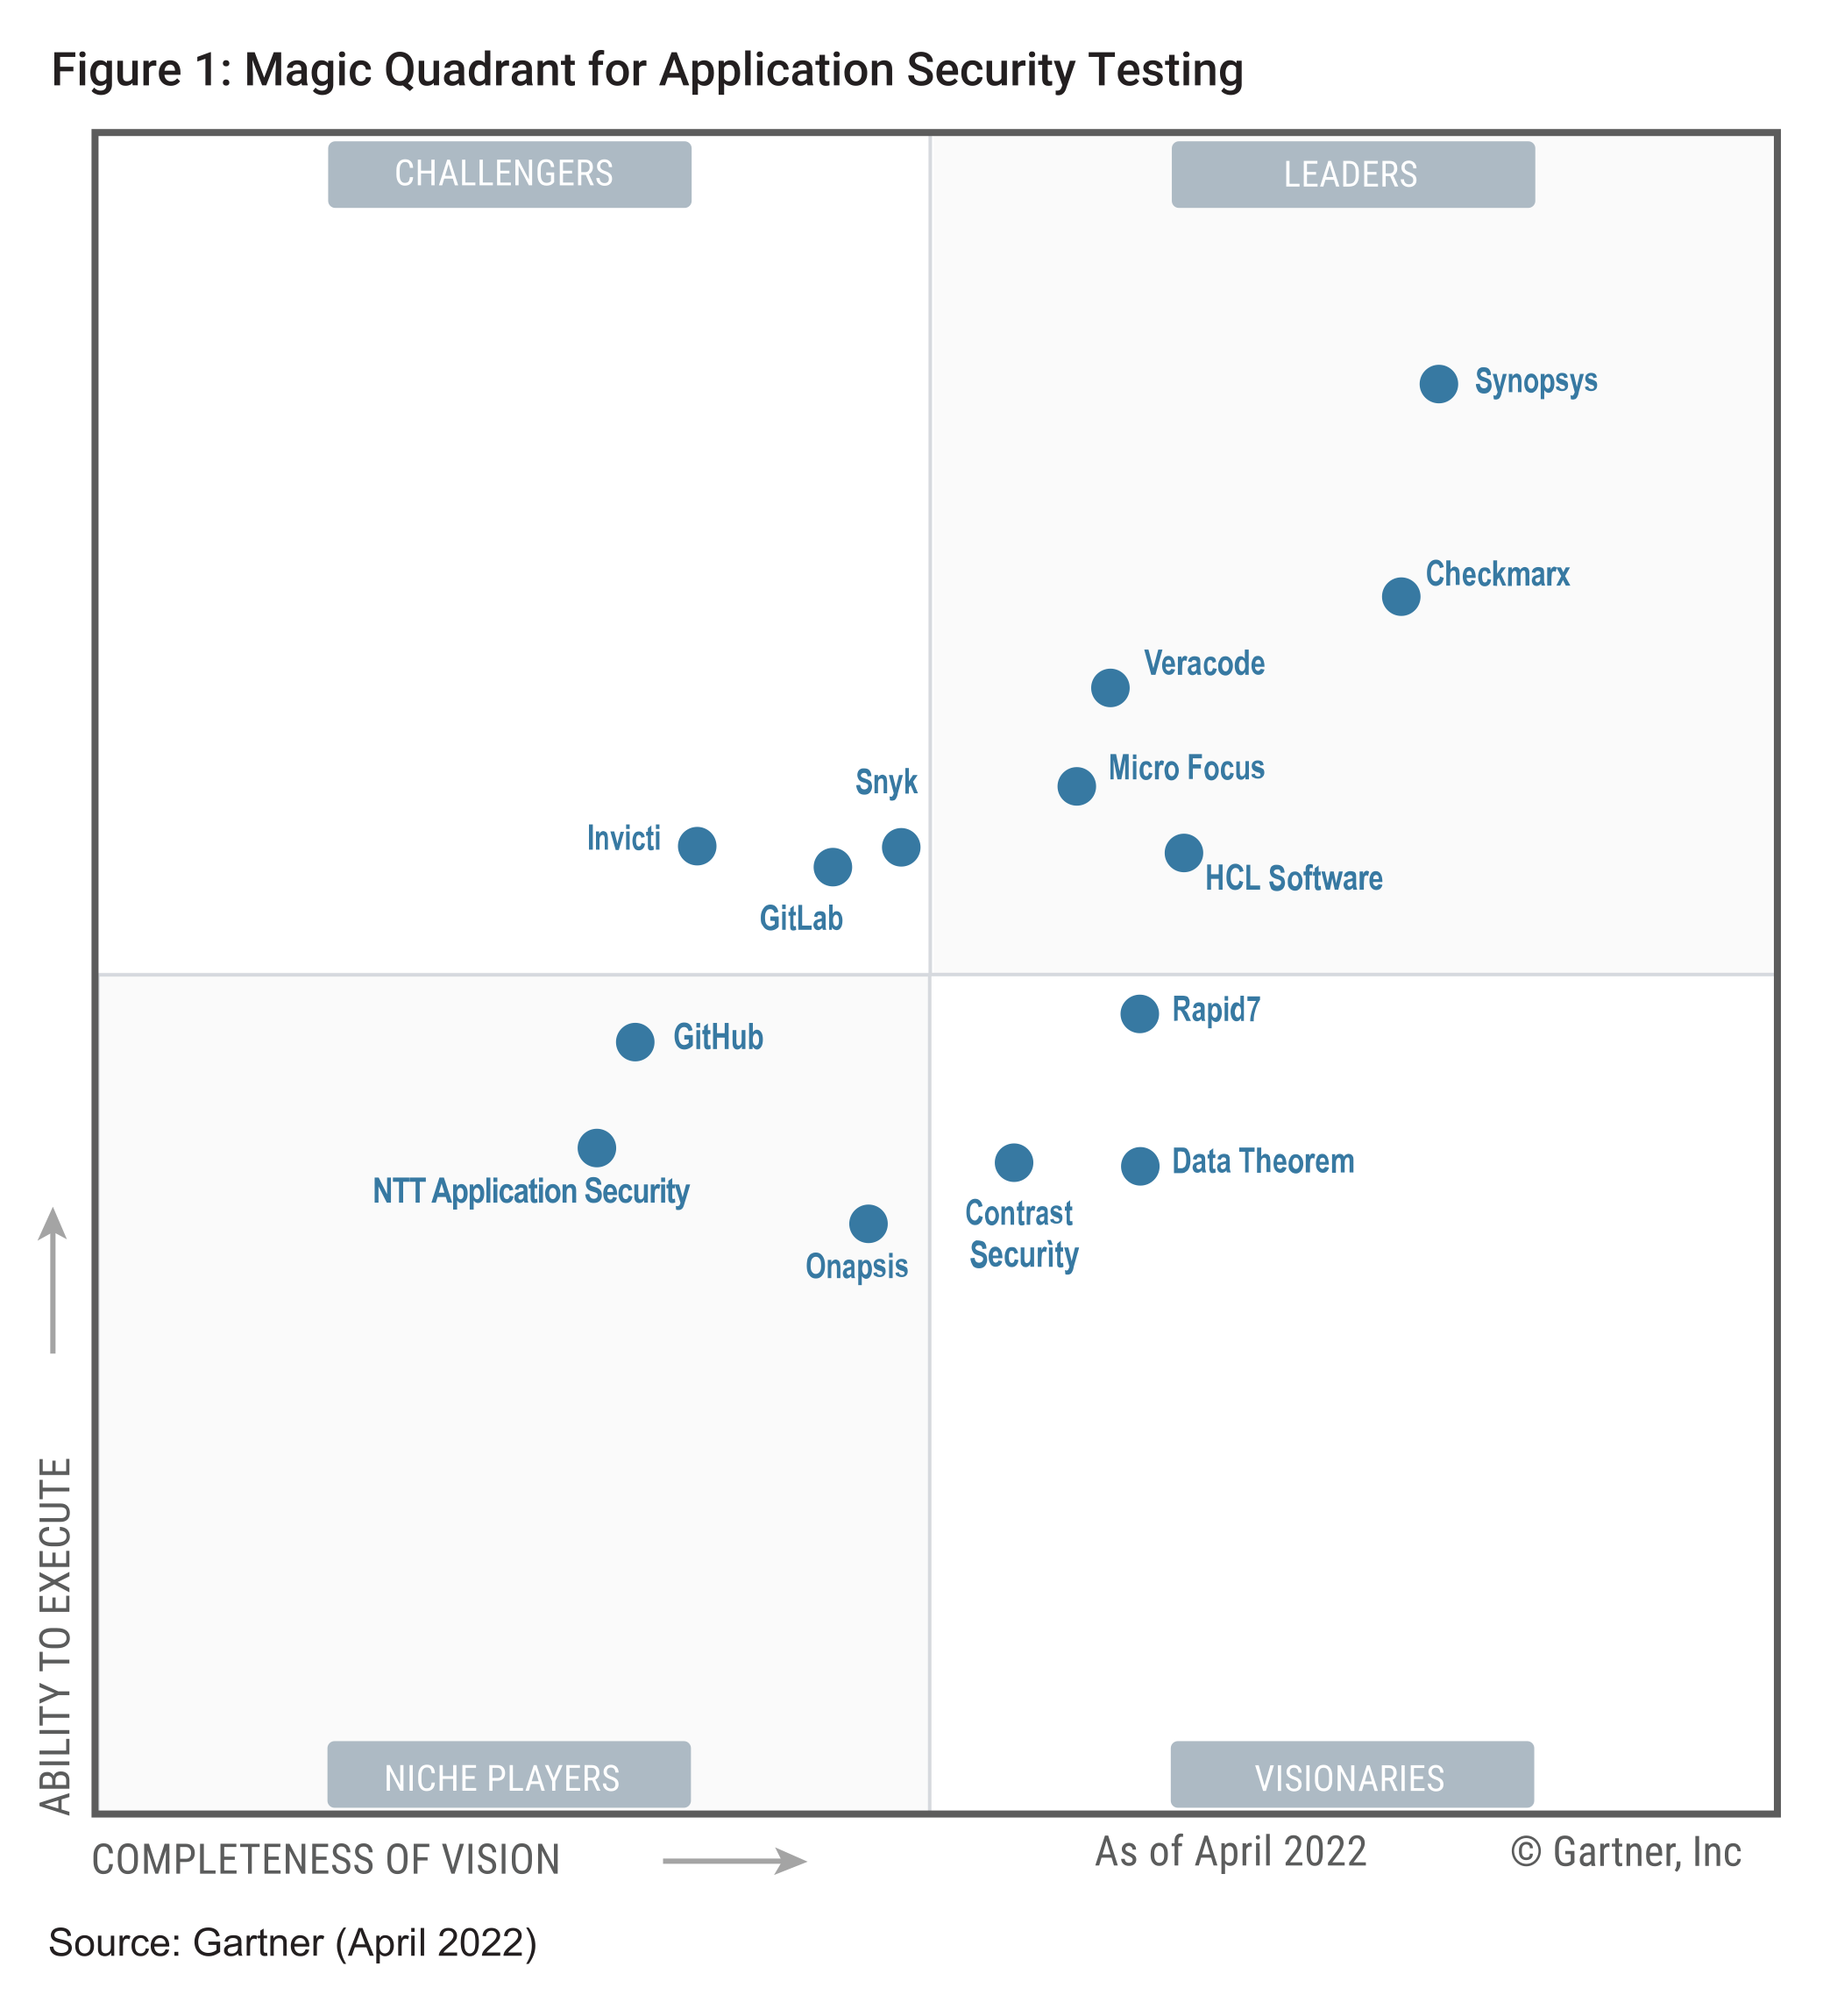
Attacking the Problem
Gartner Magic Quadrant

Slide 32
Demo!
Code Sight IDE Plugin

Slide 33
Demo!
Point and Scan

Slide 34
Questions?

