Slide 1
Case Study
Equipment Resiliency in a Critical Infrastructure environment
-Achieving millisecond failover times in a critical process environment
Kirk Reid
Industrial Controls & Cybersecurity specialist
TC Energy

Slide 2
Agenda
Introductions
Safety Moment
What is this all about?
History of the issue / What has changed
Typical site diagram
Options:
  Flex Links
  Spanning Tree
  REP
  Routing ECMP/OSPF/IS-IS/EIGRP
  VX Lan
  Switch Stacking/Etherchannel
Final Solution & Conclusions

Slide 3
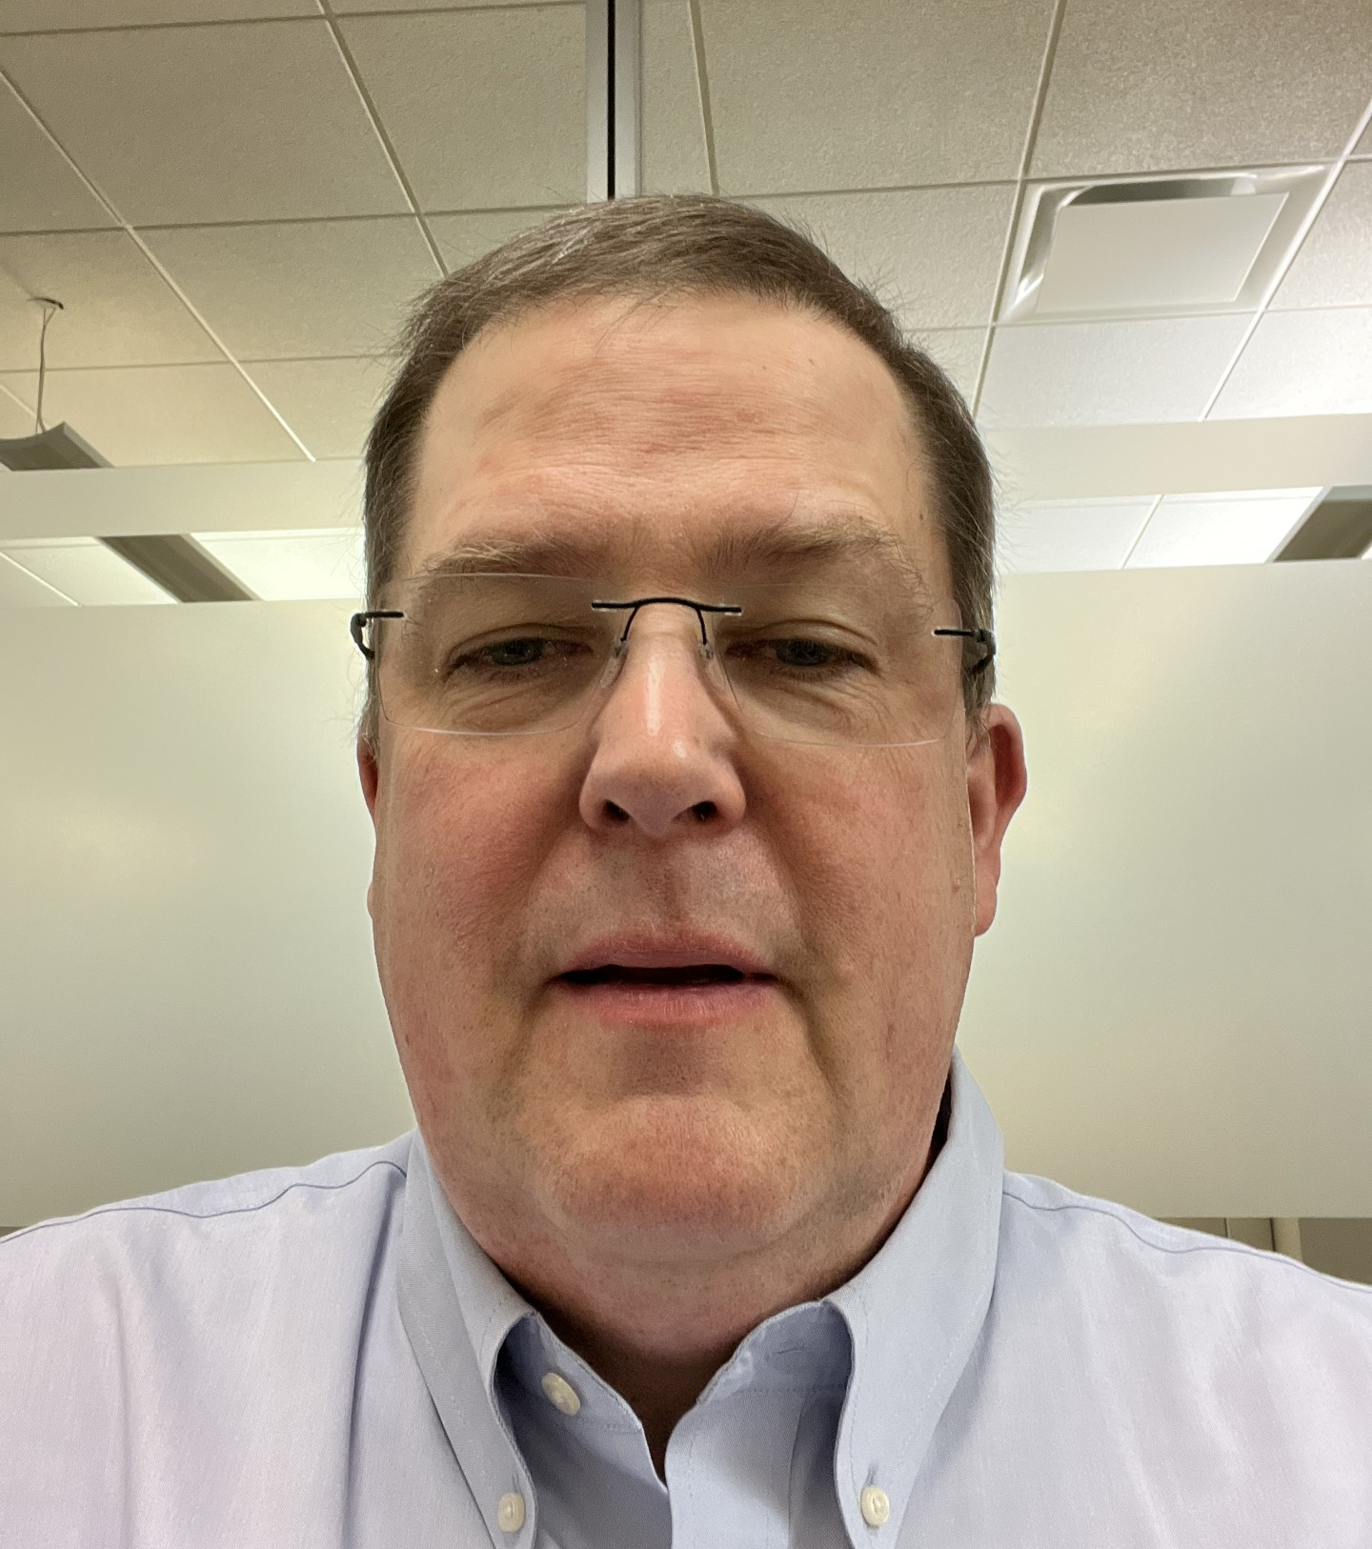
Introductions
Kirk Reid
Industrial Controls & Cybersecurity Specialist
30 years of experience in IT, specializing for the past 20 years of networking and security.
For the last 8 years at TC, Kirk has been leading the modernization of their IT and OT networks across 7000 sites in North America.

Slide 4
Dangers of Li-on/Rechargeable Batteries
Lithium rechargeable batteries have made rechargeable devices increasingly common, but poor manufacturing practices of such batteries have caused numerous accidents and fires.
Examples of these include:
  The infamous Samsung Note 7s. After 35 reported overheating incidents, they are now “considered a hazmat product, and are prohibited from being taken on-board at many airlines and bus stations.”^{[1]}
  Hoverboards. The U.S. Consumer Product Safety Commission(CPSC) claims there have been more than 250 incidents caused by hoverboard fires since 2015, resulting in 2 deaths, 13 burn injuries, three smoke inhalation injuries, and more than $4 million in property damage. By June of 2016, 501,000 self-balancing scooters had been recalled.^{[2]}
As of May 22, 2019, 258 air/airport incidents involving lithium-ion batteries carried as cargo or baggage have been recorded since March 20, 1991.^{[3]}
[1] https://en.wikipedia.org/wiki/Samsung_Galaxy_Note_7
[2] https://www.cpsc.gov/Safety-Education/Safety-Education-Centers/hoverboards
[3] https://www.faa.gov/hazmat/resources/lithium_batteries/media/Battery_incident_chart.pdf

Slide 5
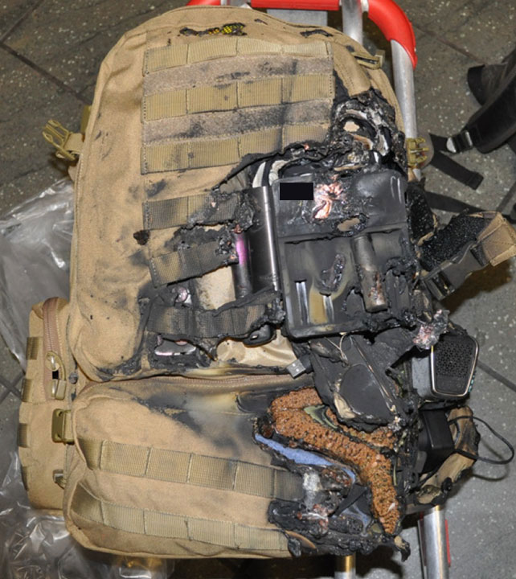
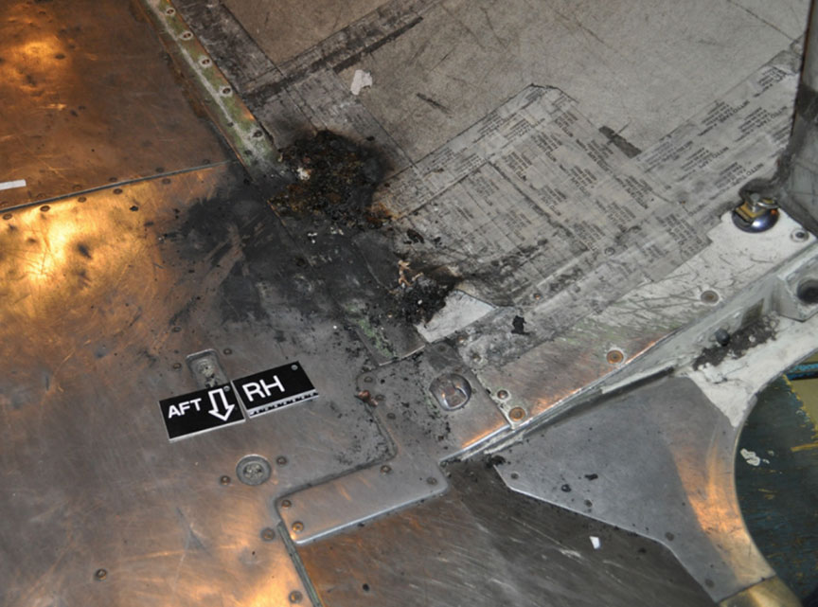
C-GWJT, Calgary, Alberta, 14 June 2018
Flight WJA113 declared a MAYDAY emergency and returned to YYC airport 3 minutes after takeoff after a cargo fire was detected.
One passenger inadvertently packed 2 spare lithium-ion batteries for his e-cigarette, in the charger, in the front pocket of his checked bag. He, aware of WestJet's policies of restricted items in checked baggage, had carried-on his e-cigarette and 2 other lithium-ion batteries.
The Transportation Safety Board of Canada (TSB) conducted an investigation following the incident. The engineering report concluded that 1 battery in the charger experienced a thermal runaway and the interior material of the battery was completely burnt out.
http://www.bst-tsb.gc.ca/eng/rapports-reports/aviation/2018/a18w0081/a18w0081.html
Notes:
The first pic is the cargo hold following the fire. Fire damage to lower aft cargo compartment
One passenger bag, found face-down near the cargo compartment door opening, showed signs of fire damage (Figure 1).
Figure 1. Passenger bag showing fire damage
By Kirk Reid

Slide 6
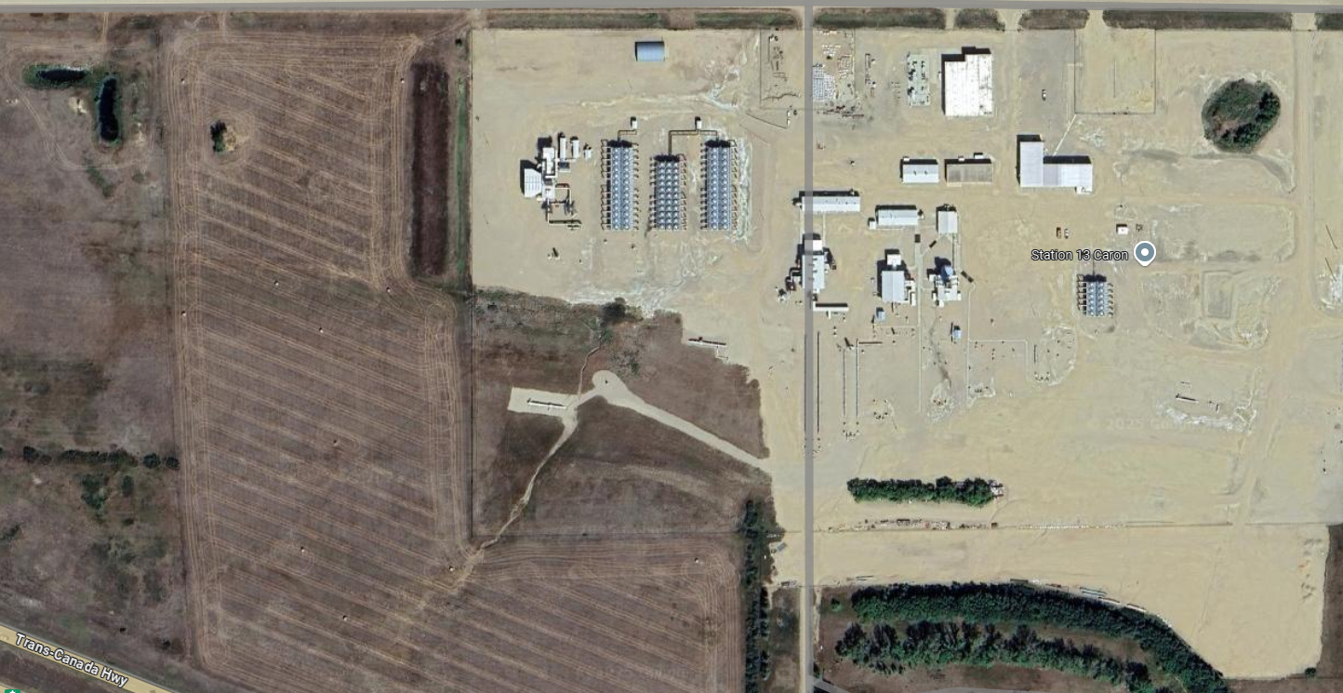
What is this all about?
About 650 km east of here
This supplies gas to Eastern Canada
BIG site (almost 1km wide)

Slide 7
How was this done before?
Everything hard wired
Onsite spares
Onsite support

Slide 8
What has changed,
Changes over the past 20 years
Wiring skills are becoming uncommon
Drive to improve reliability and do more with less (people and $)
Automation & instrumentation is moving to more and more to communication via ethernet
Fiber failures are common (30+ year old fiber)
Copper failures are common, failover convergence take seconds
Switch full failures are more common than switches hanging
Guiding Principles
Simple, supportable solutions are essential for Critical Infrastructure environments
What works in a lab doesn’t necessarily work in practice

Slide 9
Typical site diagram
IS Network: Connectivity to SCADA
  MTTR: 30 mins
Control Network: HMI
  MTTR: 1 min
Process Safety Network: PLC, RIO, ESD, MCC
  RIO: Remote IO
  ESD: Emergency Shutdown
  MCC: Motor Control
  MTTR: 100 ms

Slide 10
Problem: What if a core switch fails?
Without configuration,
connection restored in >45 sec
Site will shutdown

Slide 11
Problem: RIO switch failure
Without configuration,
connection restored in 45 sec
Site will shutdown

Slide 12
Option: Flex Links (Cisco)
Pros: Simple, scalable,
  Easy field device configurations
Cons: No longer supported
With configuration,
connection restored in <100 ms

Slide 13
Option: Spanning Tree (MST/Rapid)
Pros: Simple, scalable,
  Easy field device configurations
Cons: Does not converge fast enough
With configuration,
connection restored in <1 s

Slide 14
Option: REP
Pros: Fast reconvergence
Cons: Requires Dual ring topology, not star wiring.
Rewiring of sites required $$$$
With configuration,
connection restored in <150 ms
REP:
A ring based L2 technology

Slide 15
Option: Can we use micro-segmentation (ECMP/Routing)
Pros: Fast reconvergence
Cons: Very complicated field device configs
Does NOT mitigate RIO device failure
With configuration,
connection restored in <1 s

Slide 16
Option: VX-LAN
Pros: Fast reconvergence
Cons: Very complicated switch configurations
NOT ready for Life safety
With configuration,
connection restored in <1 s ***
Conclusion: Will be considered in the Future
VX-LAN:
Software defined L2 technology

Slide 17
Option: Switch stacking / EtherChannel
Pros: Simple, scalable,
  Easy field device configurations
Cons: Switch cluster failure
can take entire site down
With configuration,
connection restored in 50 ms

Slide 18
Final Solution & Conclusions
Due to simplicity and supportability, the switch stacking with EtherChannel solution was chosen.
Conclusions
As VxLAN continues to mature, we will analyze when it can operate with the simplicity and stringent reliability required by Critical infrastructure.
For now, the Stacking/EtherChannel represents the best operational option.

