Slide 1
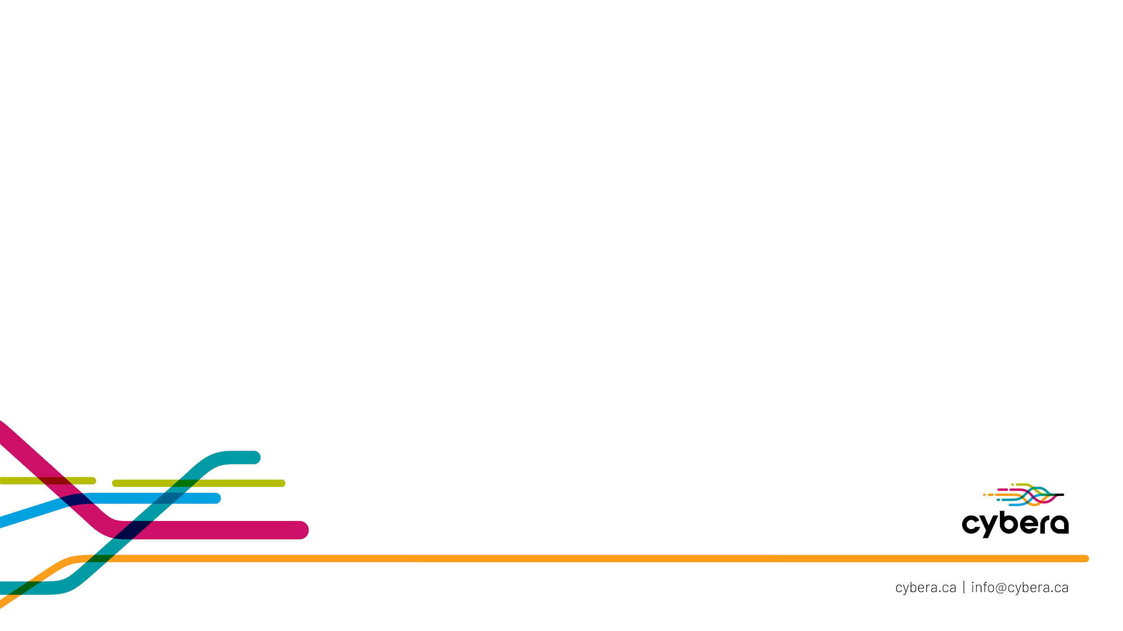
Learnings from running a free public cloud for 10 Years
Micheal Jones

Slide 2
Agenda
Context
  What is the Rapid Access Cloud?
  Who is Cybera?
What did we learn?
Q&A

Slide 3

Slide apology
My slides aren't pretty
Slide link if you're curious
  Not a rick roll :-)

Slide 4
What is the Rapid Access Cloud?

Slide 5
What is Rapid Access Cloud?
Started in 2012 - "What happens if we give folks free compute"?
OpenStack based cloud free for Albertans to use
For non-production workloads and education uses

Slide 6
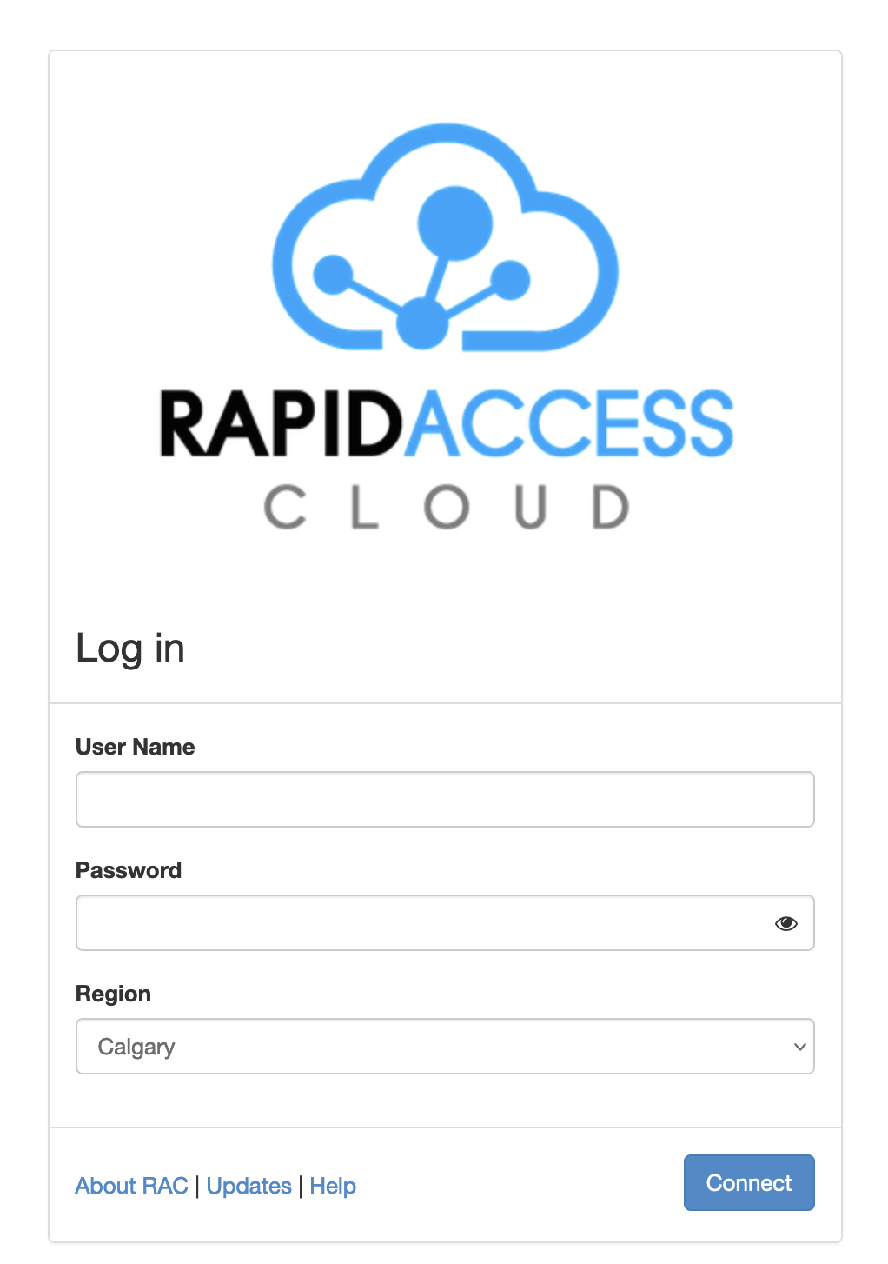

Slide 7
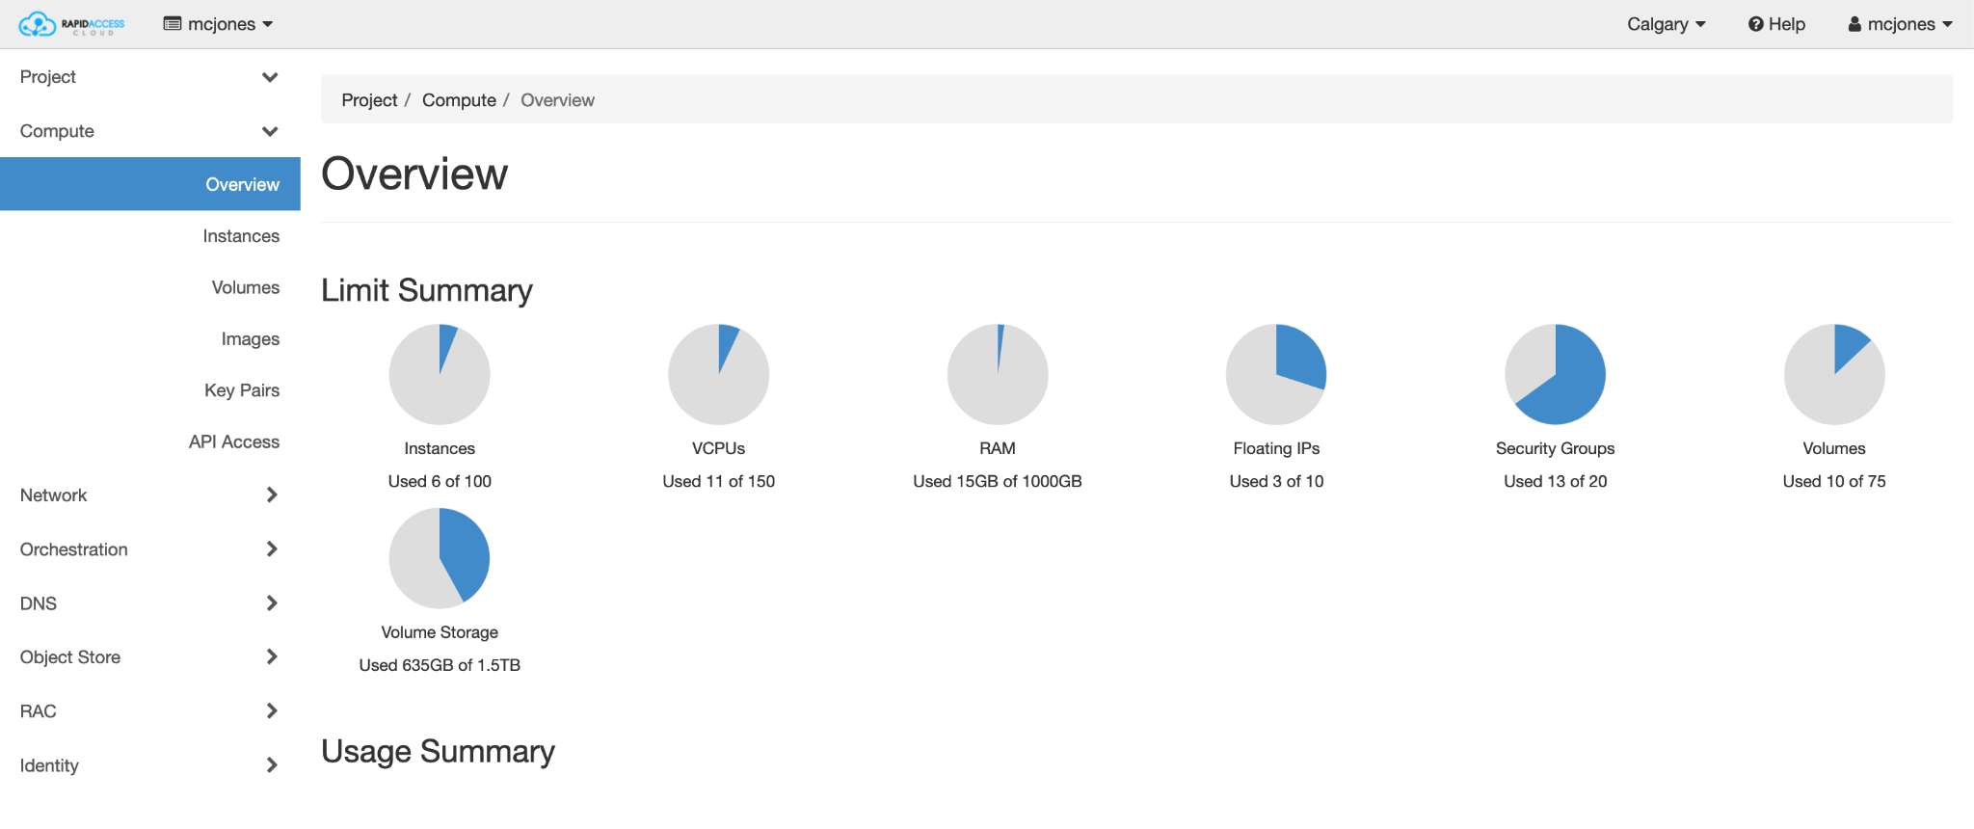

Slide 8
History in a Hurry
2012 - Started with a controller from Nebula and a handful of compute nodes
2014 - Recreated with our own deployed controllers and nodes in both Edmonton and Calgary
2016 - In conjunction with CANARIE, started incorporating GPUs
Has grown to ~1700 cores, 12TB of RAM, and ~90 TB of object storage space available to use.
Notes:
From 2016 through to 2023 - we’ve upgraded hardware, upgraded software but largely kept the service the same to focus on things that leverage the cloud

Slide 9
But who is Cybera?

Slide 10
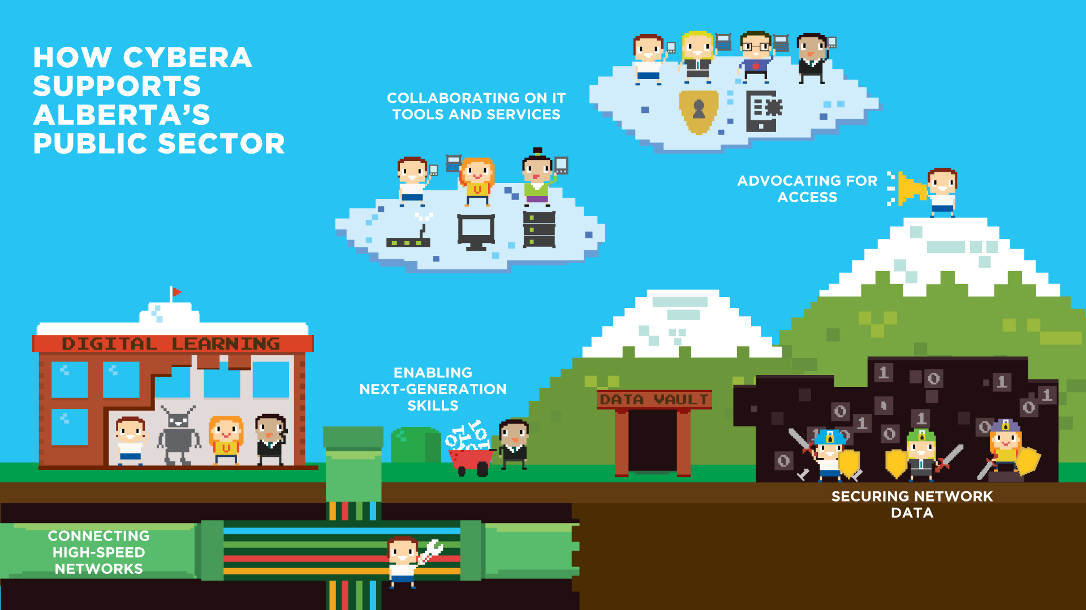

Slide 11
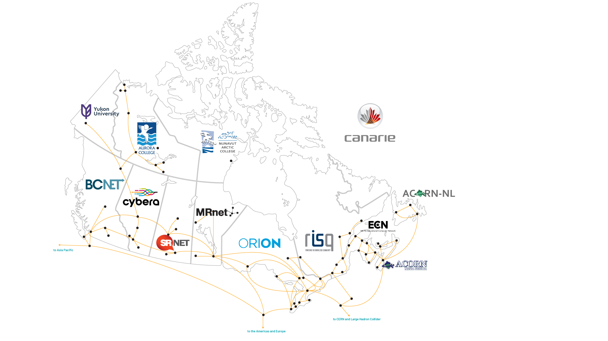
What We Do
Notes:
Maintain "The Network"
CyberaNet is the core of Cybera.
It's the physical network that provides our members access to the Research and Education Network, Peering, and Transit.
Made up of numerous network devices across Calgary, Edmonton, Lethbridge, and Red Deer.
Internet Buying Group
Virtual Firewall Service

Slide 12
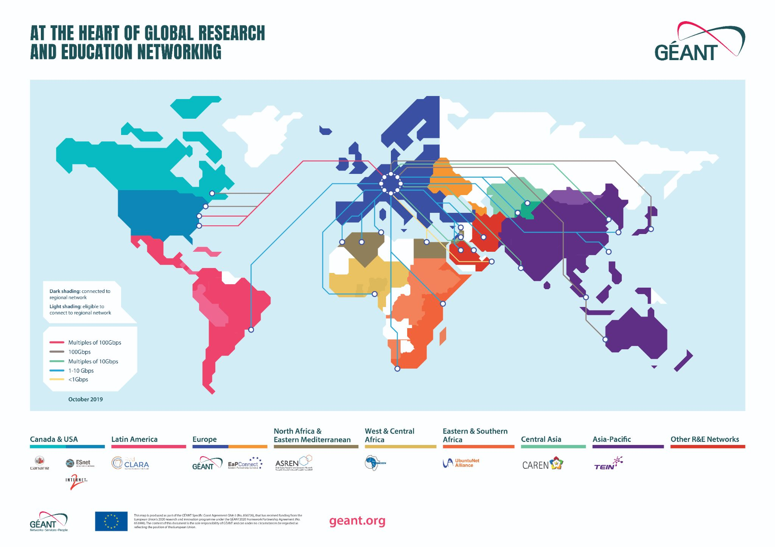
Notes:
Maintain "The Network"
CyberaNet is the core of Cybera.
It's the physical network that provides our members access to the Research and Education Network, Peering, and Transit.
Made up of numerous network devices across Calgary, Edmonton, Lethbridge, and Red Deer.
Internet Buying Group
Virtual Firewall Service

Slide 13
Also Other Services
Shared procurement
Internet Buying Group for K-12 school boards in the province
Data Science Training and Programs
Callysto (Jupyter Notebooks and Curriculum for Grade 5-12)

Slide 14
What'd we learn?
Notes:
When are technical learnings ultimately not operational learnings anyway?

Slide 15
Are you an OpenStack admin or ???
Dependency Management - Day 2 doesn't mess around.
  MySQL clusters
  RabbitMQ clusters
  Human processes
  Abstraction management
Notes:
Really big longer term learnings were the addages of you are what you eat. If you manage your dependencies you better know how to manage your dependencies when they crap the bed as well.

Slide 16
Are you an OpenStack admin or ???
Complex systems tend to… get more complex.
What would you say to how a failing hard drive in Edmonton led to a Calgary network outage?
  Root Cause Analysis is useful - but not the end of the story. It's also a useful way to lie to yourself.
Notes:
Really big longer term learnings were the addages of you are what you eat. If you manage your dependencies you better know how to manage your dependencies when they crap the bed as well.

Slide 17
Are you an OpenStack admin or ???
OpenStack is Python "glue" on top of known technologies
  Libvirt/KVM
  iSCSI
  Linux Bridging
Metrics and GUI apps are awesome
strace, tcpdump, sar, and nc get the job done
Notes:
Really big longer term learnings were the addages of you are what you eat. If you manage your dependencies you better know how to manage your dependencies when they crap the bed as well.

Slide 18
IP Addressing
RAC offers public IPv4 AND IPv6 addresses
You can never have enough IPv4 addresses and there are not enough.
  One class of 150 CompSci students can burn through your address pool real fast

Slide 19
IP Addressing
IPv6 scares folks - because change is scary.
IPv6 adoption in Alberta is… not great.
  TELUS - supposedly on every home connection
  Shaw/Rogers - some modems but not all
  Everyone else - mixed bag if it's turned on
  Universities - very slow
  Supernet - still doesn't support it at all.

Slide 20
"Free" is hard
How do you keep support manageable?
  Documentation!
  Expectations
How do you keep resources available?
How do you handle that you've removed the market force to encourage less waste?
  Do you actually see more experimentation with the constraint removed?

Slide 21
"Free" is hard
What is the operational tradeoff?
  Hardware ages. Hardware breaks. Software needs updates.
  GPUs just keep getting more expensive each year

Slide 22
Community is priceless
OpenStack Foundation did a good job fostering and creating communities
  Mailing Lists
  IRC
  Conferences
Global - we're worked with folks all over the world with it
One of my favourite sayings from Kubernetes folks was "how do we not repeat OpenStack's mistakes?"
Notes:
Community means documentation. Community means questions. Community means collaboration

Slide 23
Containerization is awesome
Not exactly new in 2014, and definitely not new now BUT
It’s a fantastic approach operationally.
  Solved a lot of issues of running several Python services along side and avoiding conflicts between versions.
Embracing CI/CD is "easier" with containers

Slide 24
Abuse
Far less common than you may presume
Far less common != not at all
Attacks targeting bad configs on the cloud are a much bigger deal.

Slide 25
What'd we learn?
Trust in humanity - people will surprise you.
Trust but verify.
Design for people - making things secure, private, the default and easy option pays off.

Slide 26
Importance of Self Hosting - Services
Commodity level services is a hard sell
  Email - most of our email is already on Google or Microsoft's servers.
  Anti-spam and dealing with blacklists is hard.
Services that are latency sensitive, or key to the business
  File Sharing (eg. documents, video)

Slide 27
Importance of Self Hosting - Infrastructure
Cloud services can get expensive quickly.
  The tradeoff is real - not needing to manage your hardware and have the elasticity is fantastic. Unless you don't need those features.

Slide 28
What did we get wrong about self hosting?
The desire to avoid managing hardware is bigger than we thought
  People not interested in hardware.
  Changing dead hard drives is tedious and not fun.
Underestimating the value of outsourcing "the hard bits"
  Physical security, data protection certifications
Notes:
What did we get wrong about self hosting our own infrastructure instead of just using market options?

Slide 29
What things surprised you?
Minecraft Servers
OwnCloud

Slide 30
Network Virtualization
Just like how physical compute hardware was moved, people want to move network devices as well
NFV is even more selective about it’s location
  Similar to how compute is best placed close to your data
  So for us - virtual firewalls for members makes sense.
The network path is everything (YYCIX shoutout)

Slide 31
"Cloudy" is hard
https://xkcd.com/1053/

Slide 32
"Cloudy" is Hard
Our users tend to be very new to the "cloud"
Word of mouth or post secondary students/researchers
Hardware Requirements != Cloud Requirements
How do we better help those new to cloud, or even new to using a hosted services use them more effectively?

Slide 33
Fads
We'd love to better identify passing fads versus industry changing
What we do know
  If the change doesn't noticeably (10x rule of thumb) improve things it's not worth the change
But what do we know really?
  The old will be new again as folks reinvent or try previously tried approaches to new or even similar problems.

Slide 34
The Future of RAC

Slide 35
We can not, should not, and are not interested in competing with AWS, Azure, or GCP.
Is there still a place for this when the big 3 have free tiers?
We don’t know for sure - but we do know for static workloads, self hosting outweighs cloud costs.

Slide 36
Thank you!
Questions? Contact rac-admin@cybera.ca

