Slide 1
Remote Collaboration
Alternatives to Zoom
Alan Dewar
Software Engineer Staff, Synopsys

Slide 2
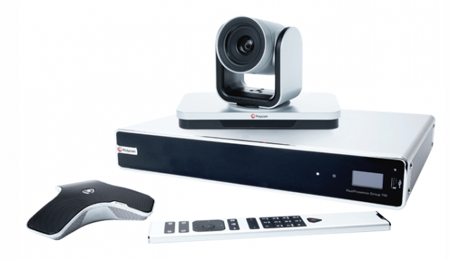
High-End Solutions

Slide 3
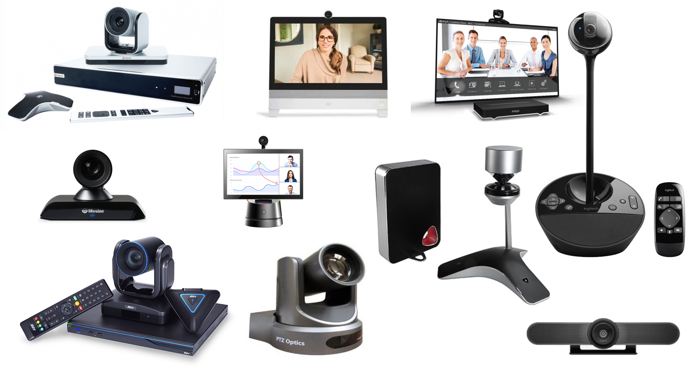
High-End Solutions

Slide 4
High-End Solutions
Polycom RealPresence Group 700 – Feature-rich and easily scalable
Cisco Webex DX80 – Compatible with Webex, unique collaboration tools
Avaya XT5000 – Simple screen sharing, easy to use interface
Lifesize Icon 700 – Compatible with Lifesize Cloud, 4K compatible
Logitech MeetUp – Wide angle is great for small rooms
Polycom CX5100 – Skype intergration, active speaker tracking
AVer EVC950 – One touch recording, mobile-enabled annotation
Logitech BCC950 – Competitively priced, Zoom, Webex, Skype integration
ezTalks Meet Mini – Affordable, cloud recording and storage
PTZOptics PT12X-SDI – Customizable, 3D noise cancellation technology
https://tech.co/web-conferencing/best-video-conferencing-equipment

Slide 5
High-End Prices
Polycom RealPresence Group 700 – $16,999
Cisco Webex DX80 – $2,390
Avaya XT5000 – $8,000-$10,000
Lifesize Icon 700 – $7,499
Logitech MeetUp – $899
Polycom CX5100 – $5,000
AVer EVC950 – $8,999
Logitech BCC950 – $250
ezTalks Meet Mini – $699
PTZOptics PT12X-SDI – $1,599
https://tech.co/web-conferencing/best-video-conferencing-equipment

Slide 6
Skype
August 2003: first release
September 2005: acquired by eBay for $2.6 billion
May 2011: acquired by Microsoft
  100 million users
2014: Oxford English Dictionary
2015: 300 million users
July 2016: alpha client for Linux

Slide 7
Skype
Initially not well-suited to mobile devices
Reliability issues
Usability issues
  Frequent redesigns
Account required

Slide 8
Zoom
April 2011: founded by Eric Yuan, former VP at Cisco Webex, + 40 engineers
January 2013: first release
April 2019: IPO
October 2020: market cap $140 billion
  More than ExxonMobil

Slide 9
2021 Market Share
Zoom
Google Meet
Microsoft Teams
Skype
Slack
House Party
Google Hangouts
GoToMeeting
48.69
21.81
14.54
6.55
3.58
1.60
1.31
1.07
BigBlueButton
Lifesize
ClickMeeting
Nextiva
RingCentral Glip
Bluejeans Meetings
U Meeting
RingCentral Video
0.59
0.12
0.05
0.04
0.02
0.01
0.00
0.00
https://docs.google.com/spreadsheets/d/1Zl2rlNCVTm0m_kX9_zQCc45xFOF1MS7Xzfyh7XGFOmk/

Slide 10
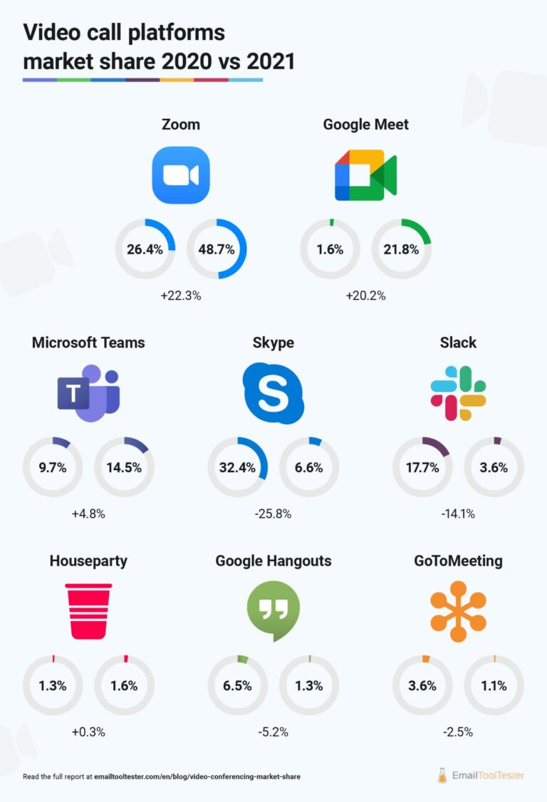
https://www.emailtooltester.com/en/blog/video-conferencing-market-share/

Slide 11
Zoom
https://zoom.us
50 – 500 max capacity (10,000 webinar)
Linux support

Slide 12
Google Meet
https://meet.google.com
Formerly known as Hangouts Meet
100 – 250 max capacity
Linux support

Slide 13
Microsoft Teams
https://teams.live.com
Replaces discontinued Skype for Business
10 max capacity free; 10,000 paid
Linux support

Slide 14
Skype
https://www.skype.com
50 max capacity
Partial Linux support

Slide 15
House Party
https://houseparty.com
“Virtual living room”
8 max capacity
Acquired by Epic Games in 2019
Shutting down in October 2021

Slide 16
Jitsi Meet
https://meet.jit.si
75 max capacity
LGPL, GPL
Linux support

Slide 17
Discord
https://discord.com
Multi-player gaming VOIP replacement
…and a lot more
50 max capacity
Linux support

Slide 18
Many More
https://en.wikipedia.org/wiki/Web_conferencing
https://en.wikipedia.org/wiki/Comparison_of_web_conferencing_software

Slide 19
Do-It-Yourself
https://www.html5rocks.com/en/tutorials/webrtc/basics/
https://io13webrtc.appspot.com/

Slide 20
Demos
Zoom
Google Meet
Microsoft Teams
Skype
House Party
Jitsi Meet
Discord

Slide 21
Thank You!

